Slide 1


Dwi Emas International School
SummerPlace (MM2H) Sdn. Bhd.
All rights reserved.

Slide 2
School Information
Year Established
2015
Average Class Size
20 - 25 students
Number of Students
450
Age Range
Ages 4 to 16
Curriculum
Cambridge IGCSE
Foreign Language
Bahasa Malaysia and Mandarin
Boarding
YES
Transport
YES
Ratio of local students to international student
80% local students to 20% expat students
SummerPlace (MM2H) Sdn. Bhd.
All rights reserved.

Slide 3
Academic
Primary
Secondary
Key Stage 1 - 2
Key Stage 3 - 4
SummerPlace (MM2H) Sdn. Bhd.
All rights reserved.

Slide 4
Primary Key Stage 1 – 2
Subjects
English
Science (KS2)
Mathematics
Bahasa Melayu
Chinese
Mortensen Mathematics
ICT
International Primary Curriculum (IPC)
Science (KS1)
History
Geography
Society
Technology
International
Sports
Dodgeball
Basketball
Futsal
The Arts
Dance
Art & Design
Swimming
Volleyball
Cheerleading
Badminton (KS2)
Table Tennis (KS2)
Netball (KS2)
Music
Drama
SummerPlace (MM2H) Sdn. Bhd.
All rights reserved.

Slide 5
Secondary Key Stage 3 – 4
Key Stage 3 Subjects
English
Mathematics
Biology
Physics
Chemistry
History
Geography
Bahasa Melayu
Chinese
ICT
Key Stage 4 Subjects
English
Mathematics
Physics
Chemistry
Bahasa Melayu
Chinese
ICT
Elective Subjects (Choose 2 Or 3 Only)
Biology (Compulsory for IKS 41)
Economics (Compulsory for IKS 41)
Additional Mathematics
Accounting
Global Perspectives
Enterprise
SummerPlace (MM2H) Sdn. Bhd.
All rights reserved.

Slide 6
Secondary Key Stage 3 – 4
Sports (Choose Two Only)
Badminton
Dodgeball
Netball
Martial Arts
Volleyball
Futsal
Cheerleading
Basketball
Table Tennis
Swimming
The Art (Choose One Only)
Art & Design
Vocal Training
Hip Hop
Drama
Makerspace
Media
SummerPlace (MM2H) Sdn. Bhd.
All rights reserved.

Slide 7
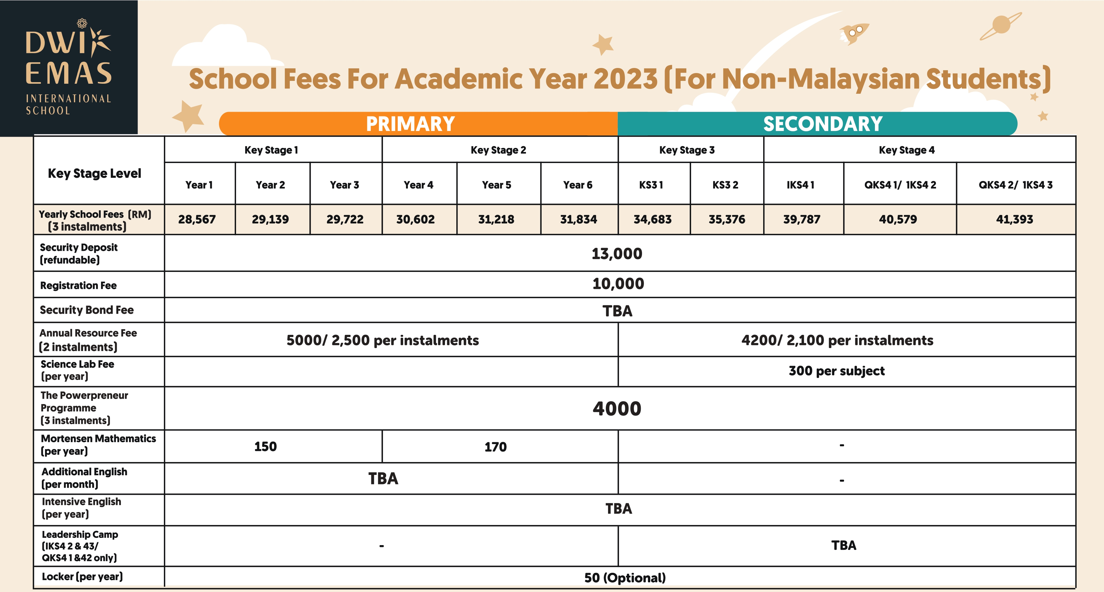
SummerPlace (MM2H) Sdn. Bhd.
All rights reserved.

Slide 8
Boarding
Link to
https://dwiemas.edu.my/transportation-boarding/
SummerPlace (MM2H) Sdn. Bhd.
All rights reserved.

Slide 9
Facilities
Air-conditioned classrooms
Library
Swimming pool
Canteen/Cafeteria
Infirmary room
IT Resource Centre
Science Laboratory
Art room
Makerspace
Activities rooms
Playground
Basketball court
Badminton court
Multi-purpose Hall
Futsal court
Volleyball court
Netball court
Refer to https://dwiemas.edu.my/our-campus/ for more information
SummerPlace (MM2H) Sdn. Bhd.
All rights reserved.

Slide 10




Awards & Recognition
Cambridge University Students' Union
Rated 96% by Education Alliance Finland (EAF)
Baby Talk & Mama Papa Readers' Choice Award 2021
Ultimate Nation Builder Award
SummerPlace (MM2H) Sdn. Bhd.
All rights reserved.

